Slide 1

Project Title:
30% Presentation Template
Abdul Muhaim FA21-BSE-081
Asad Khan FA21-BSE-081
Furqan Ahmad FA21-BSE-089
Sir Javed Raza
Department of Computer Science
COMSATS University Islamabad, Abbottabad Campus

Slide 2
Agenda of the Presentation
Brief Introduction
Scope
Functional and Non-Functional requirements
User Goals
Use Cases and Diagrams(Use case , class diagram , sequence diagram , activity diagram etc)
Gantt Chart
Details of iterations (30% , 60%)
Conclusion

Slide 3
Brief Introduction
Overview of the Plant Disease Prediction System.
Utilizes image recognition and machine learning for accurate diagnosis.
Provides treatment recommendations and preventive measures.

Slide 4
Scope
Inclusions:
Disease Prediction: Analyze images uploaded by users to predict diseases in plants.
Real-Time Recommendations: Provide instant suggestions based on diagnosed diseases.
Weather Data Integration: Factor environmental conditions for more accurate predictions.
Multilingual Support(English/Urdu): Ensure accessibility for farmers from different linguistic backgrounds.
Exclusions:
Prediction Limitations: System limited to diseases it has been trained on.
Image Quality Requirements: Accurate predictions require high-quality images.

Slide 5
Functional Requirements
User Authentication & Profile Management
Signup/login functionality.
Role-based access control (farmers, experts, admins).
Disease Prediction via Image Upload
Preprocessing and prediction of diseases using a machine learning model.
Plant Health Monitoring
Track multiple plants and their health over time.
Disease Information & Recommendations
A database of plant diseases with treatments and prevention measures.
Weather and Environmental Integration
Real-time weather data integration to enhance predictions.
Notifications & Alerts
Real-time disease alerts and routine reminders.

Slide 6
Non-Functional Requirements
Performance:
The system should deliver accurate results within seconds of image upload.
Usability:
A user-friendly interface, accessible to users of varying technical expertise.
Scalability:
Capable of handling a growing number of users and a large disease database.
Reliability:
Ensure system uptime for critical agricultural operations.
Security:
Protect user data and ensure secure image uploads.

Slide 7
User Goals
Farmers
Early detection of plant diseases for timely treatment.
Access to treatment suggestions and preventive measures.
Monitor multiple plants and track their health over time.
Administrators
Oversee system performance and manage users.
Ensure system updates and model training with new datasets.

Slide 8
Use Cases
User Login/Signup
Actors: , Admins.
Description: Users register or log in to access system features.
Upload Plant Image
Actors: User.
Description: Upload images for disease prediction and receive a diagnosis.
View Prediction Results
Actors: User.
Description: View disease diagnosis, treatment suggestions, and preventive measures.
Manage Plant Profiles
Actors: User.
Description: Add, update, and monitor multiple plants over time.
Access Disease Database
Actors: User.
Description: Search for specific diseases and view symptoms, causes, and treatments.
User Management
Actors: Admin.
Description: Manages user account.

Slide 9
Continue…
Model Monitoring
Actors: Admin.
Description: Allows the admin to monitor the performance of the disease prediction model.
Data Upload
Actors: Admin.
Description: Provides functionality for the admin to upload new datasets for model training or updates.
Generate Report
Actors: Admin.
Description: Allows the admin to generate detailed reports of prediction results.
View Disease Diagnose History
Actors: User.
Description: Allows users to view information about plant diseases history.

Slide 10
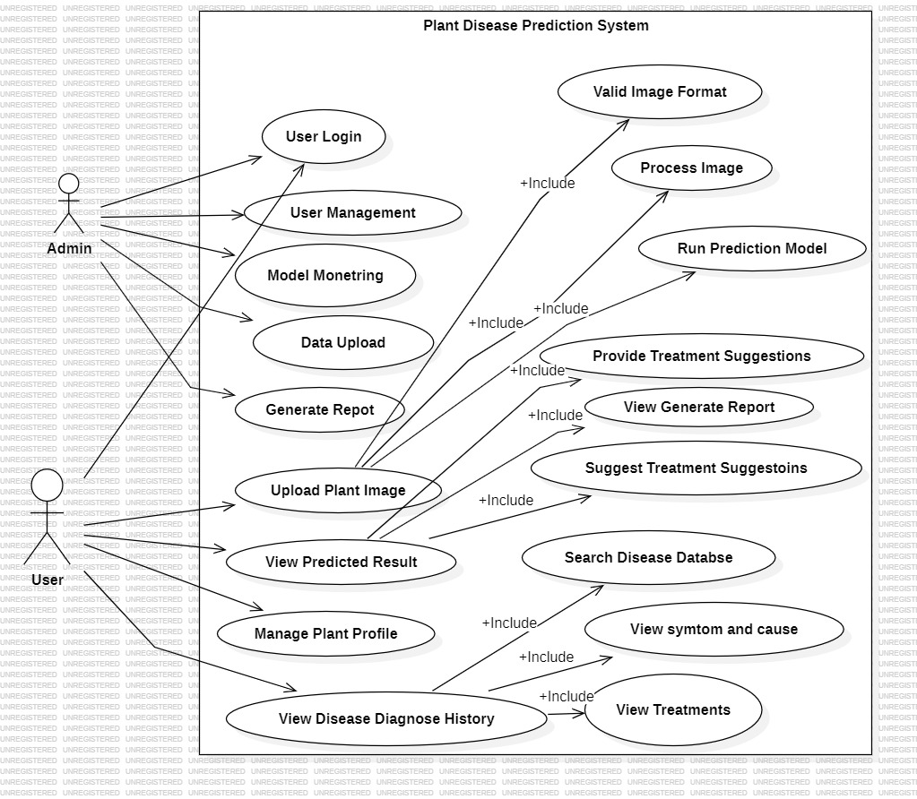
Use Case Diagram

Slide 11
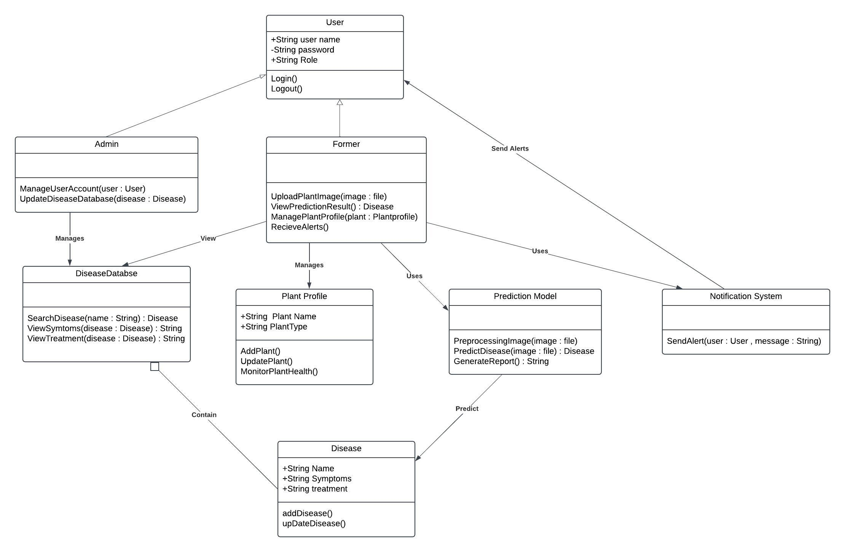
Class Diagram

Slide 12
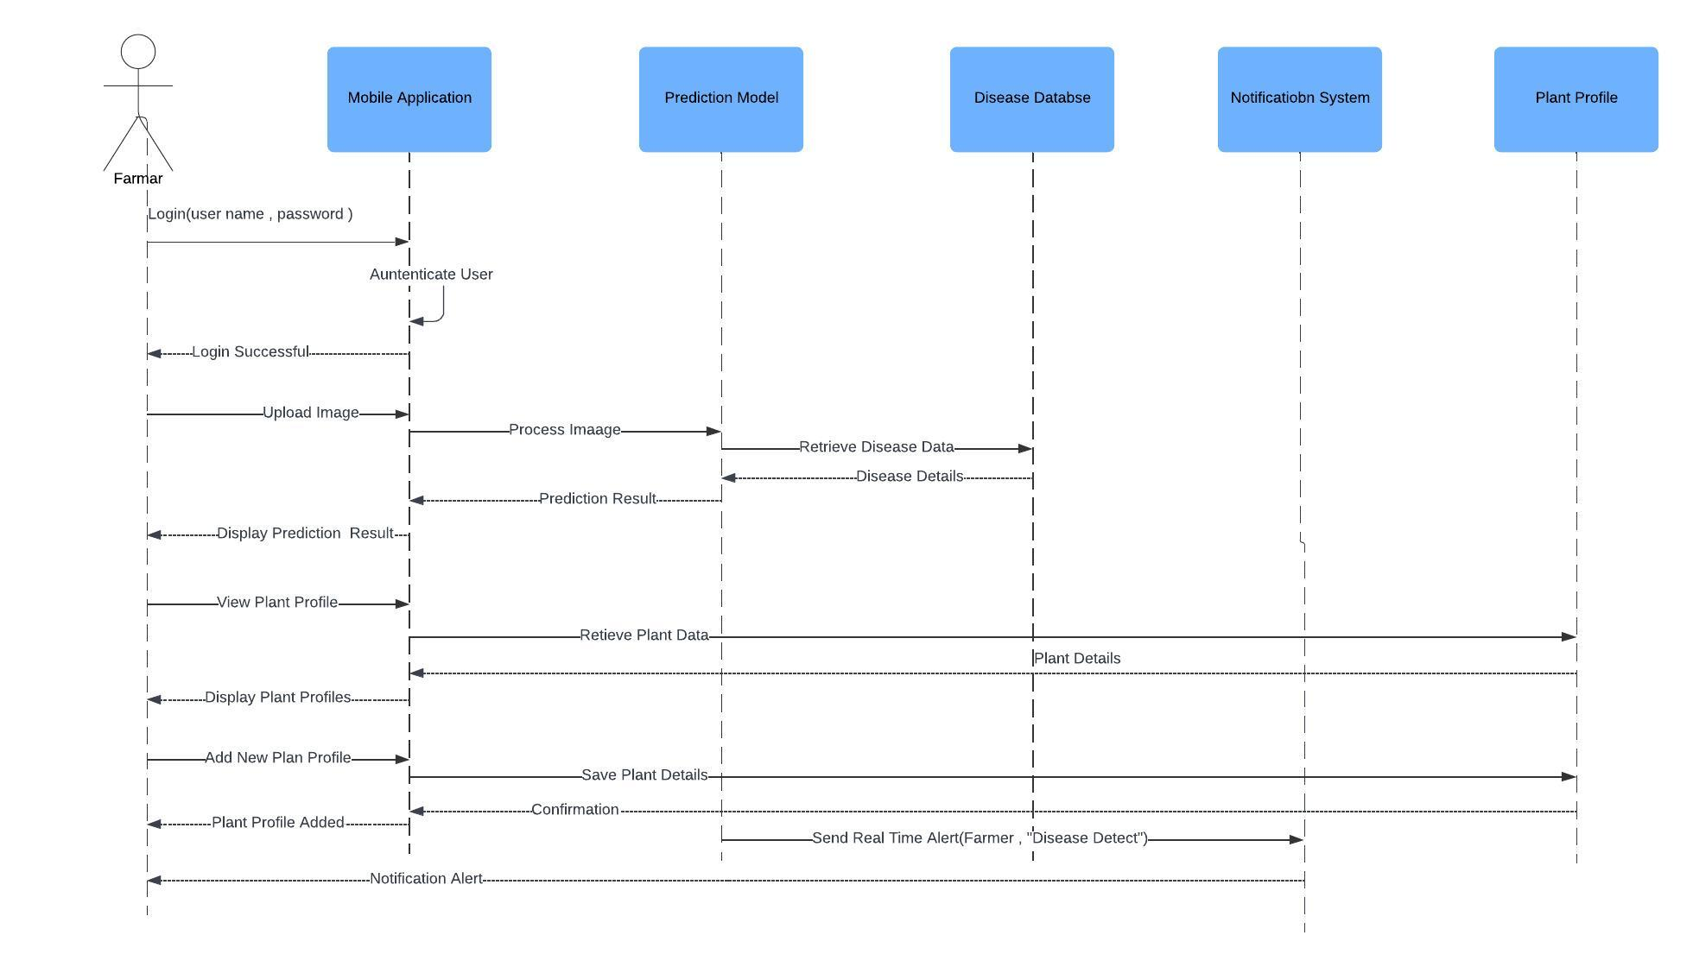
Sequence Diagram

Slide 13
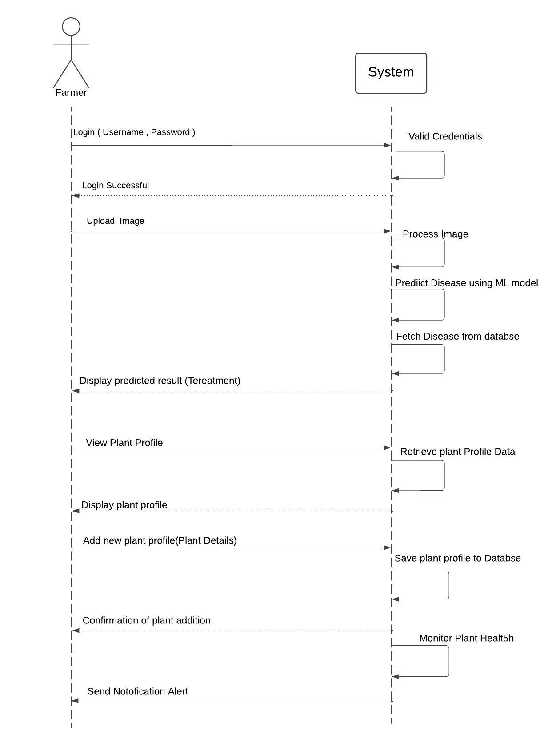
System Sequence Diagram

Slide 14
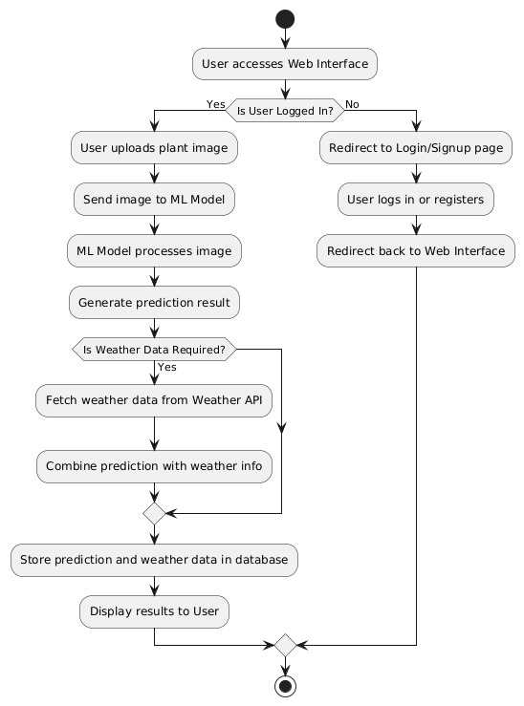
Activity/State Machine Diagram

Slide 15
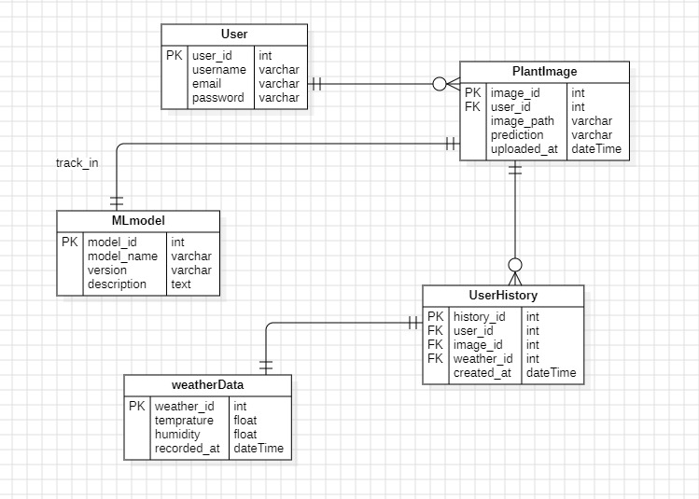
ER Diagram

Slide 16
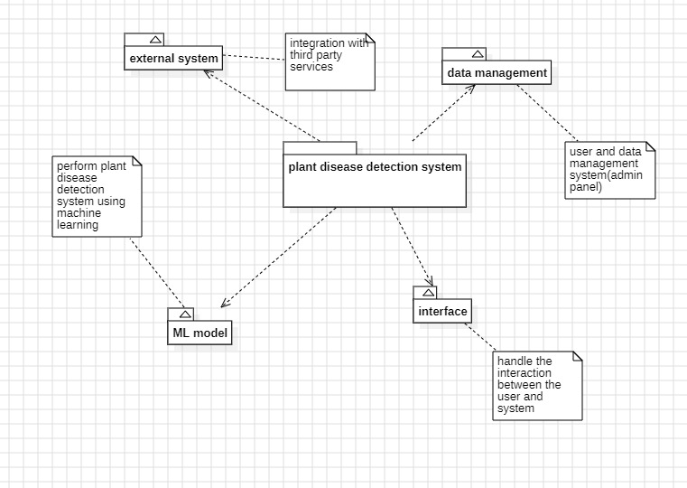
Package Diagram

Slide 17
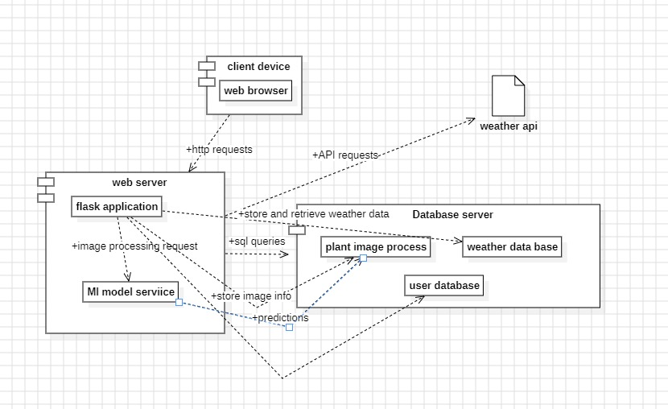
Deployment Diagram

Slide 18
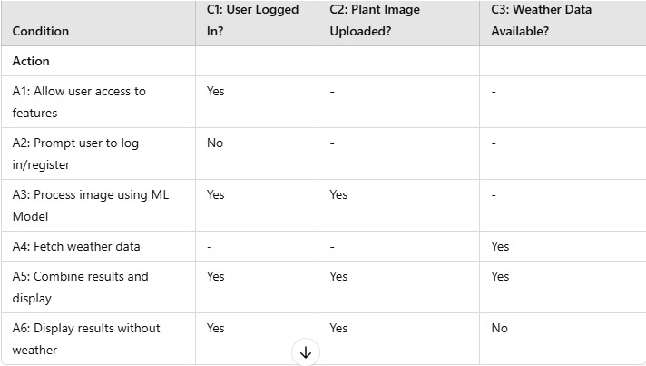
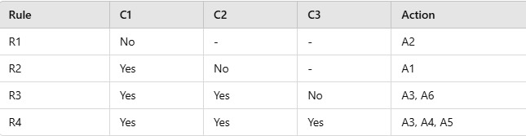
Decision Table, Pseudocode

Slide 19
Continue…

Slide 20
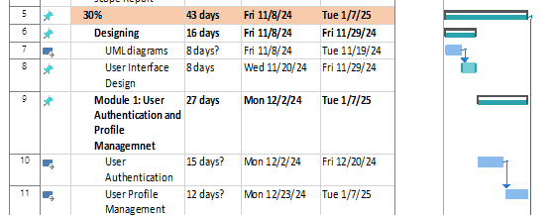
Schedule

Slide 21
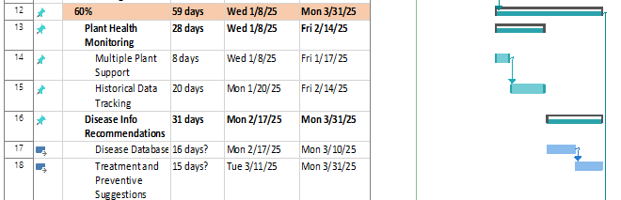
Schedule

Slide 22
Details of 1st Iteration (30%)
Design Use-Case Diagram, Class Diagram, Sequence Diagrams.
ER Diagram and DFDs (Levels 0, 1, 2).
Initial UI designs.
Implemented basic user authentication and profile management.

Slide 23
Details of 2nd Iteration (60%)
Development of disease prediction module with image processing and machine learning.
Integration of weather and environmental data for enhanced diagnosis.
Notifications and alerts functionality.
Addition of plant health monitoring features.

Slide 24
Conclusion
The Plant Disease Prediction System helps farmers detect plant diseases early using machine learning and image recognition. Integrating environmental data and real-time notifications, it reduces crop losses and boosts yields. The system is progressing well and aims to be a reliable, user-friendly, and globally accessible solution.

